Slide 1
Name Candidate number
Practical portfolio

Slide 2
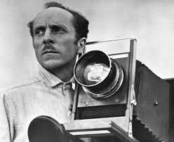
Focus (Your artist)
Who are you studying and why
Brief biog
Something on their work and style
Impact on the medium
What do you like about their work

Slide 3
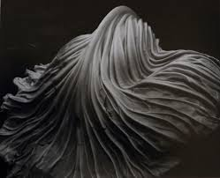
Analysis of their work
Brief analysis of the photo
Composition/Rules
What you like about it

Slide 4
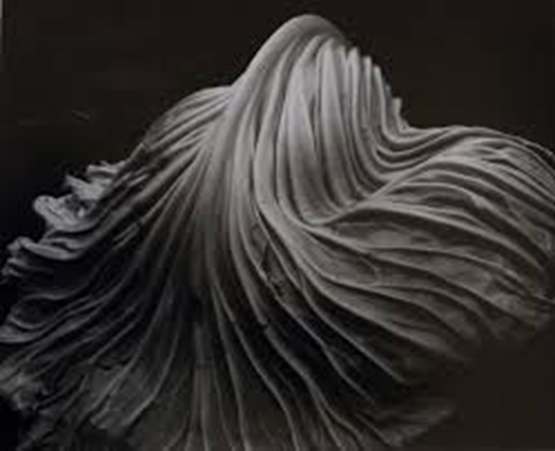
Recreation
Brief write up of your recreation
How did you do it
What have you learnt?

Slide 5
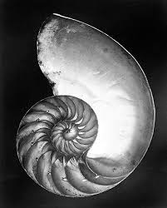
Analysis of their work
Brief analysis of the photo
Composition/Rules
What you like about it

Slide 6
Recreation
Brief write up of your recreation
How did you do it
What have you learnt?

Slide 7
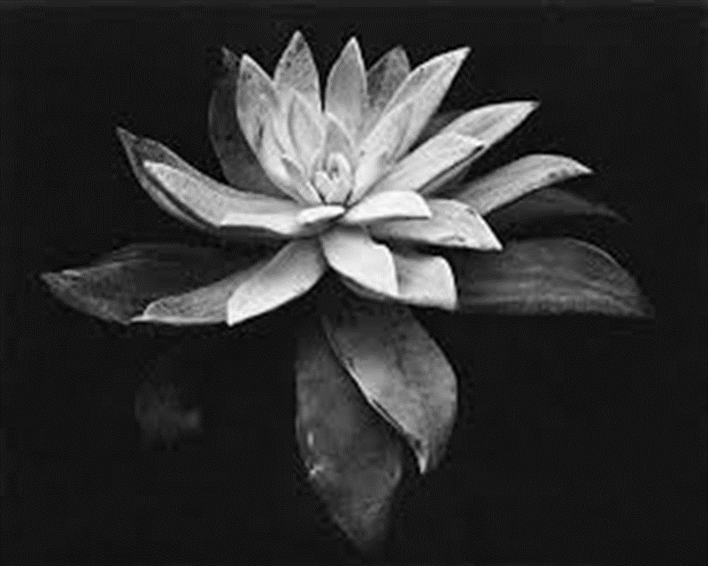
Analysis of their work
Brief analysis of the photo
Composition/Rules
What you like about it

Slide 8
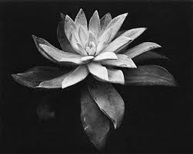
Recreation
Brief write up of your recreation
How did you do it
What have you learnt?

Slide 9
Intentions
What are you intending on looking at in your Practical Portfolio.
How are you going to use your chosen Medium as a starting point.

Slide 10
Your starting point (Mind map of initial ideas for your practical portfolio)
Portrait
Landscape
Still Life
Macro

Slide 11
Mood board
A mood board of initial ideas for your Practical Portfolio.

Slide 12
Idea 1(nature)
Your first idea should be based on the work of your chosen artist
What is your 1st idea

Slide 13
Moodboard
A moodboard of ideas for your 1st idea

Slide 14
Artist inspiration
Which artists have inspired your 1st idea

Slide 15
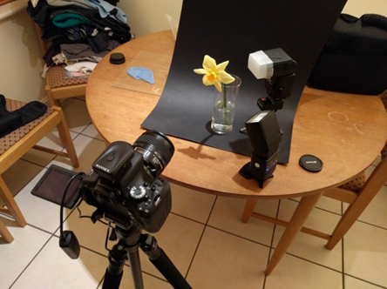
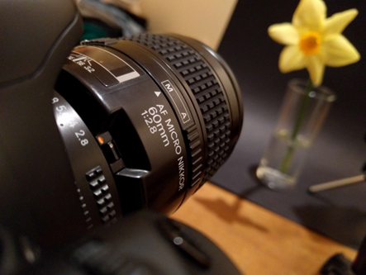
Planning for idea
Sketches of your idea
Pictures of the location or set up for your shoot
Pictures of people in your shoot

Slide 16
Test SHots

Slide 17
Test SHots

Slide 18
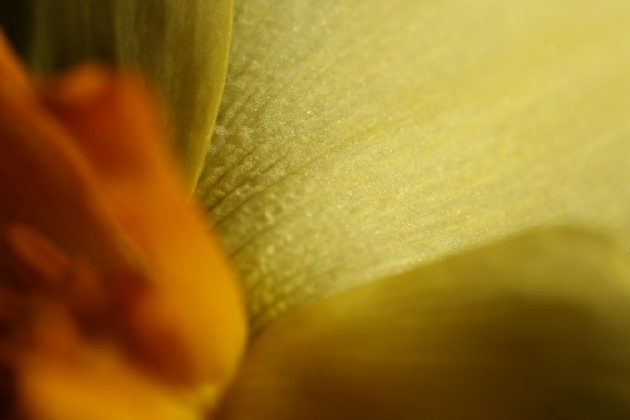
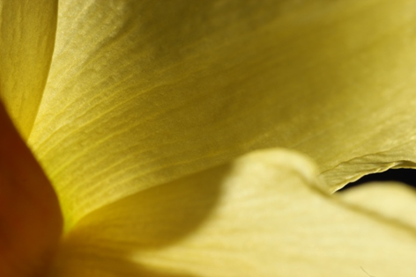
Chosen photos

Slide 19
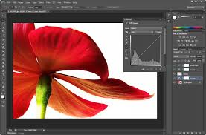
Editing process
You need to make sure that you include screen shots of your editing process. This will get you more marks

Slide 20
Final images
Include large final copies of your work

Slide 21
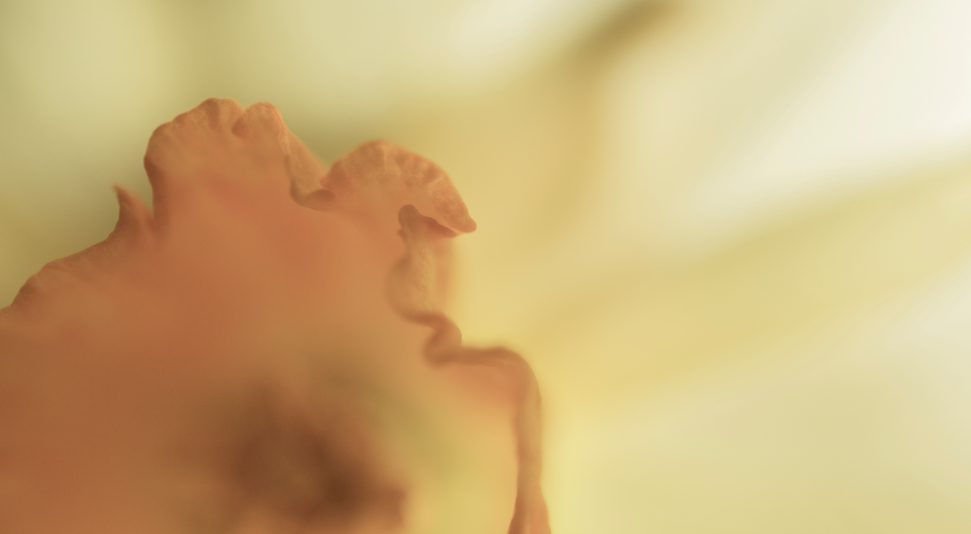

Slide 23
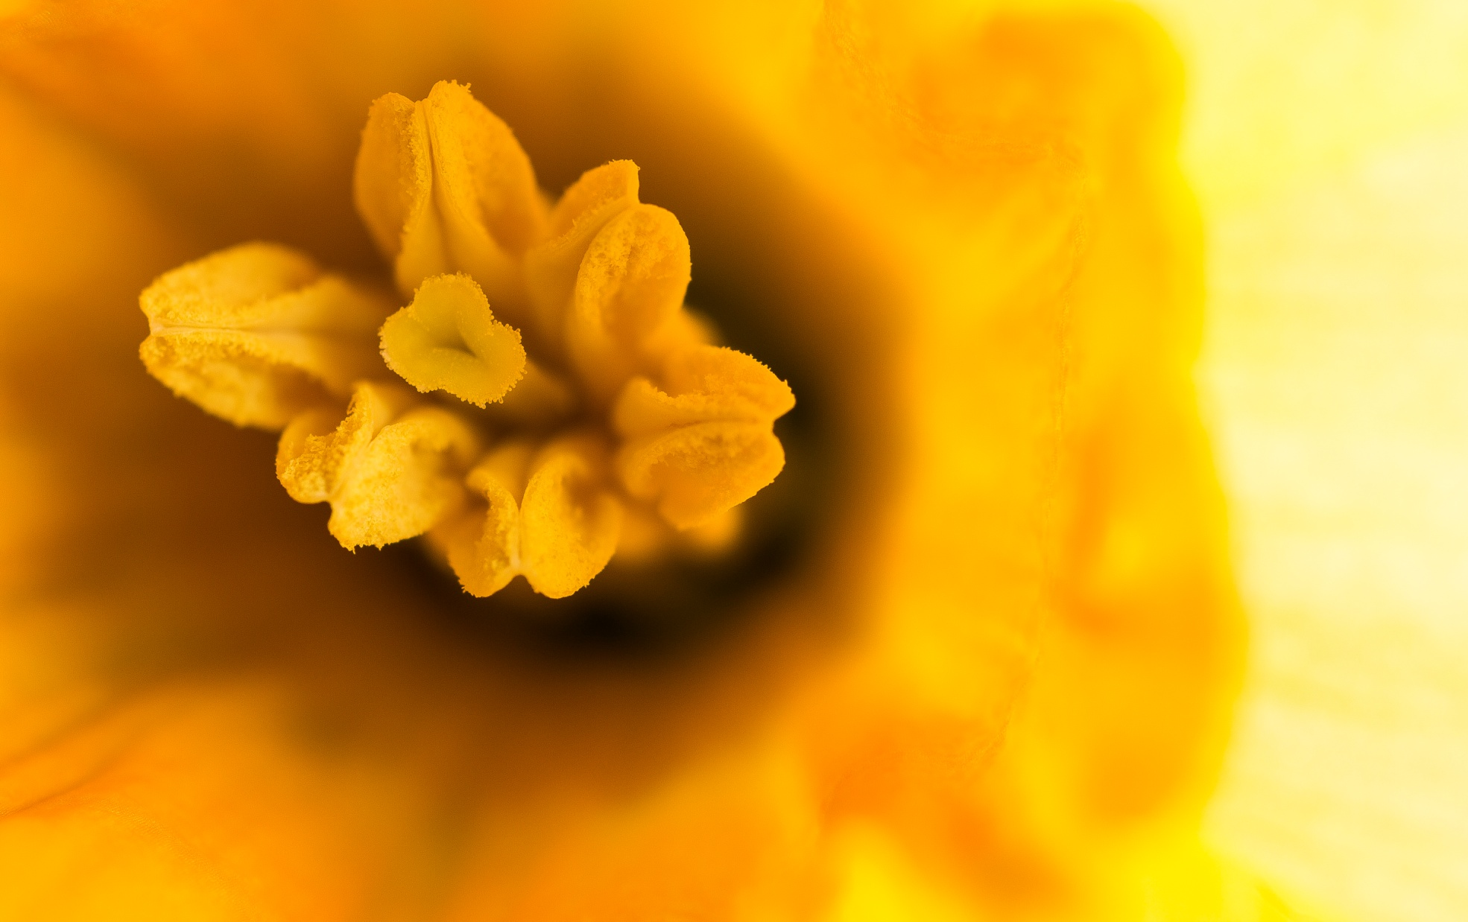

Slide 24
Development of idea
What have you learnt from your 1st idea. What are you going to focus on next

Slide 25
Test SHots

Slide 26
Test SHots

Slide 27
Chosen photos

Slide 28
Editing process
You need to make sure that you include screen shots of your editing process. This will get you more marks

Slide 30
Idea 2
What is your 2nd idea
Can be based on the work of your chosen artist or a different artist linked to them.

Slide 31
Moodboard
A moodboard of ideas for your 1st idea

Slide 32
Artist inspiration
Which artists have inspired your 1st idea

Slide 33
Planning for idea
Sketches of your idea
Pictures of the location or set up for your shoot
Pictures of people in your shoot

Slide 34
Test SHots

Slide 35
Process
You should continue this process of developing ideas until you reach your final idea
You need to make sure that you have more than one idea
Make sure that you develop each idea as this will show evidence of developing and exploring your ideas
Each idea should be a development from the 1st rather than something completely different and random from the previous idea.

Slide 36
Final Idea
What is your final idea?
What are you going to do?

Slide 37
Moodboard
A moodboard of ideas for your final idea

Slide 38
Artist inspiration
Which artists have inspired your final idea

Slide 39
Planning for idea
Sketches of your idea
Pictures of the location or set up for your shoot
Pictures of people in your shoot

Slide 40
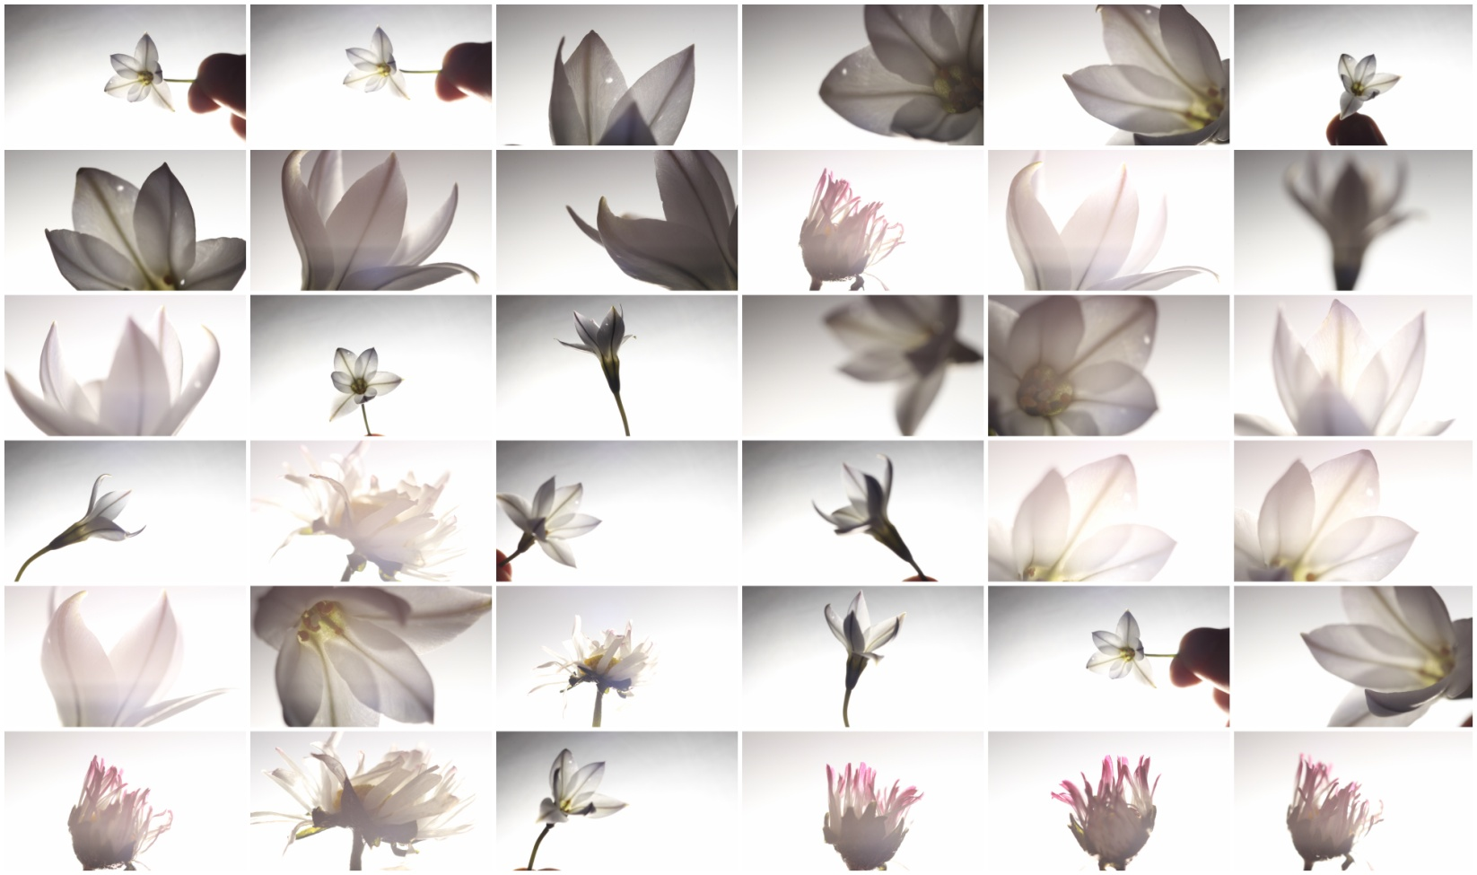
Heavenly: Test Shots

Slide 41
Heavenly: Test Shots

Slide 42
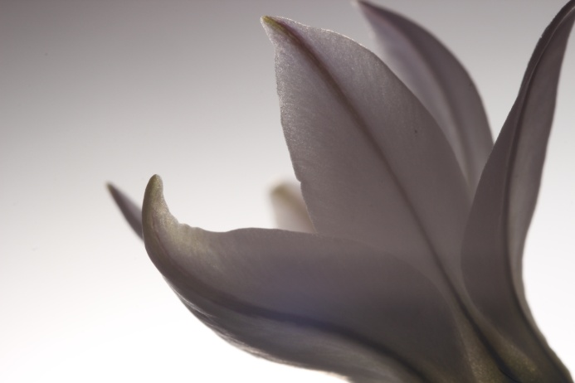
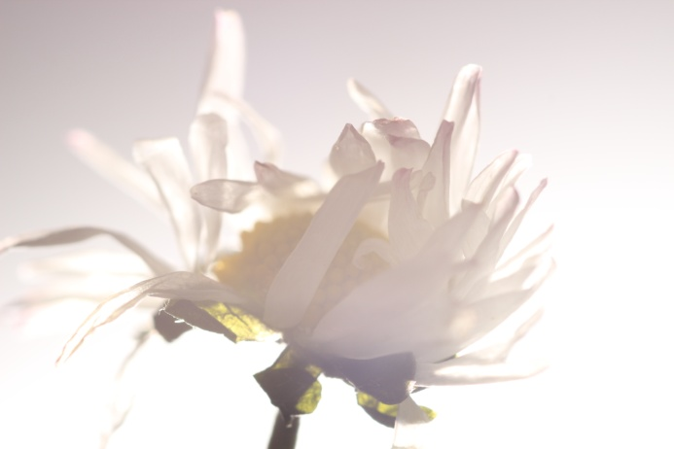
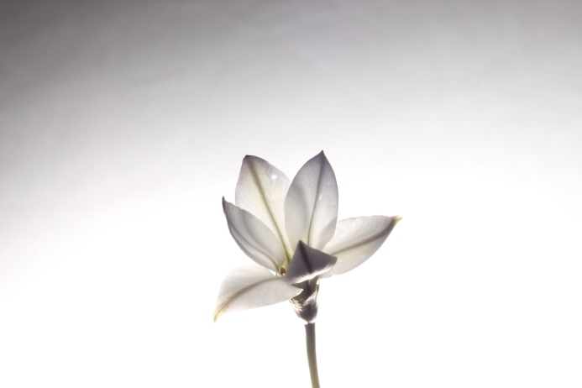
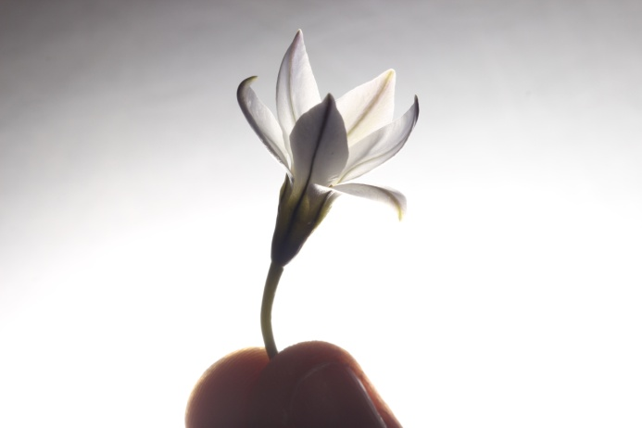
Heavenly: Selected Photos
After reviewing all of the shots I took I have selected 4 photos that I felt fit the minimalism theme. What I felt that these photos had compared to the other photos was; interesting compositions, dynamic lighting and causing the desired effect. I will now edit the photos and then narrow down to only the best images.

Slide 43
Editing process
You need to make sure that you include screen shots of your editing process. This will get you more marks

Slide 44
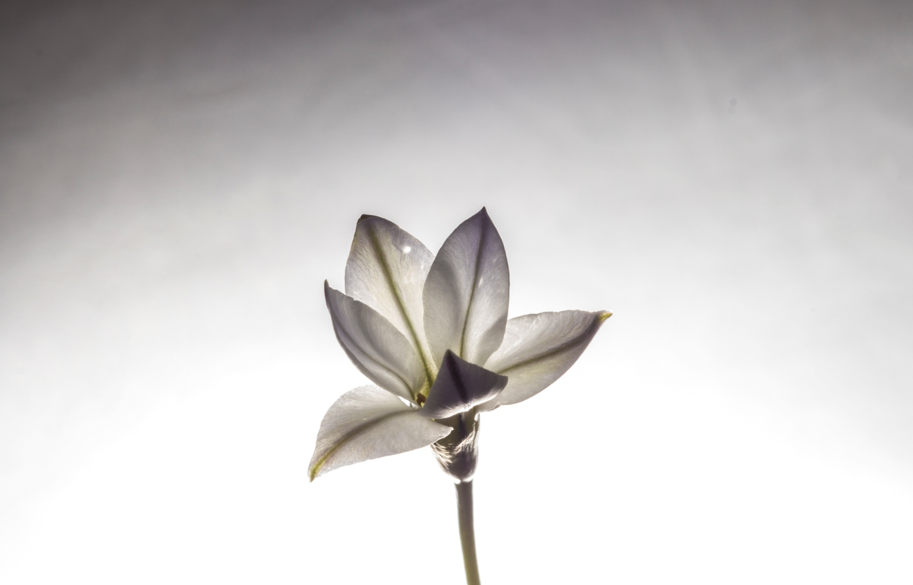

Slide 45
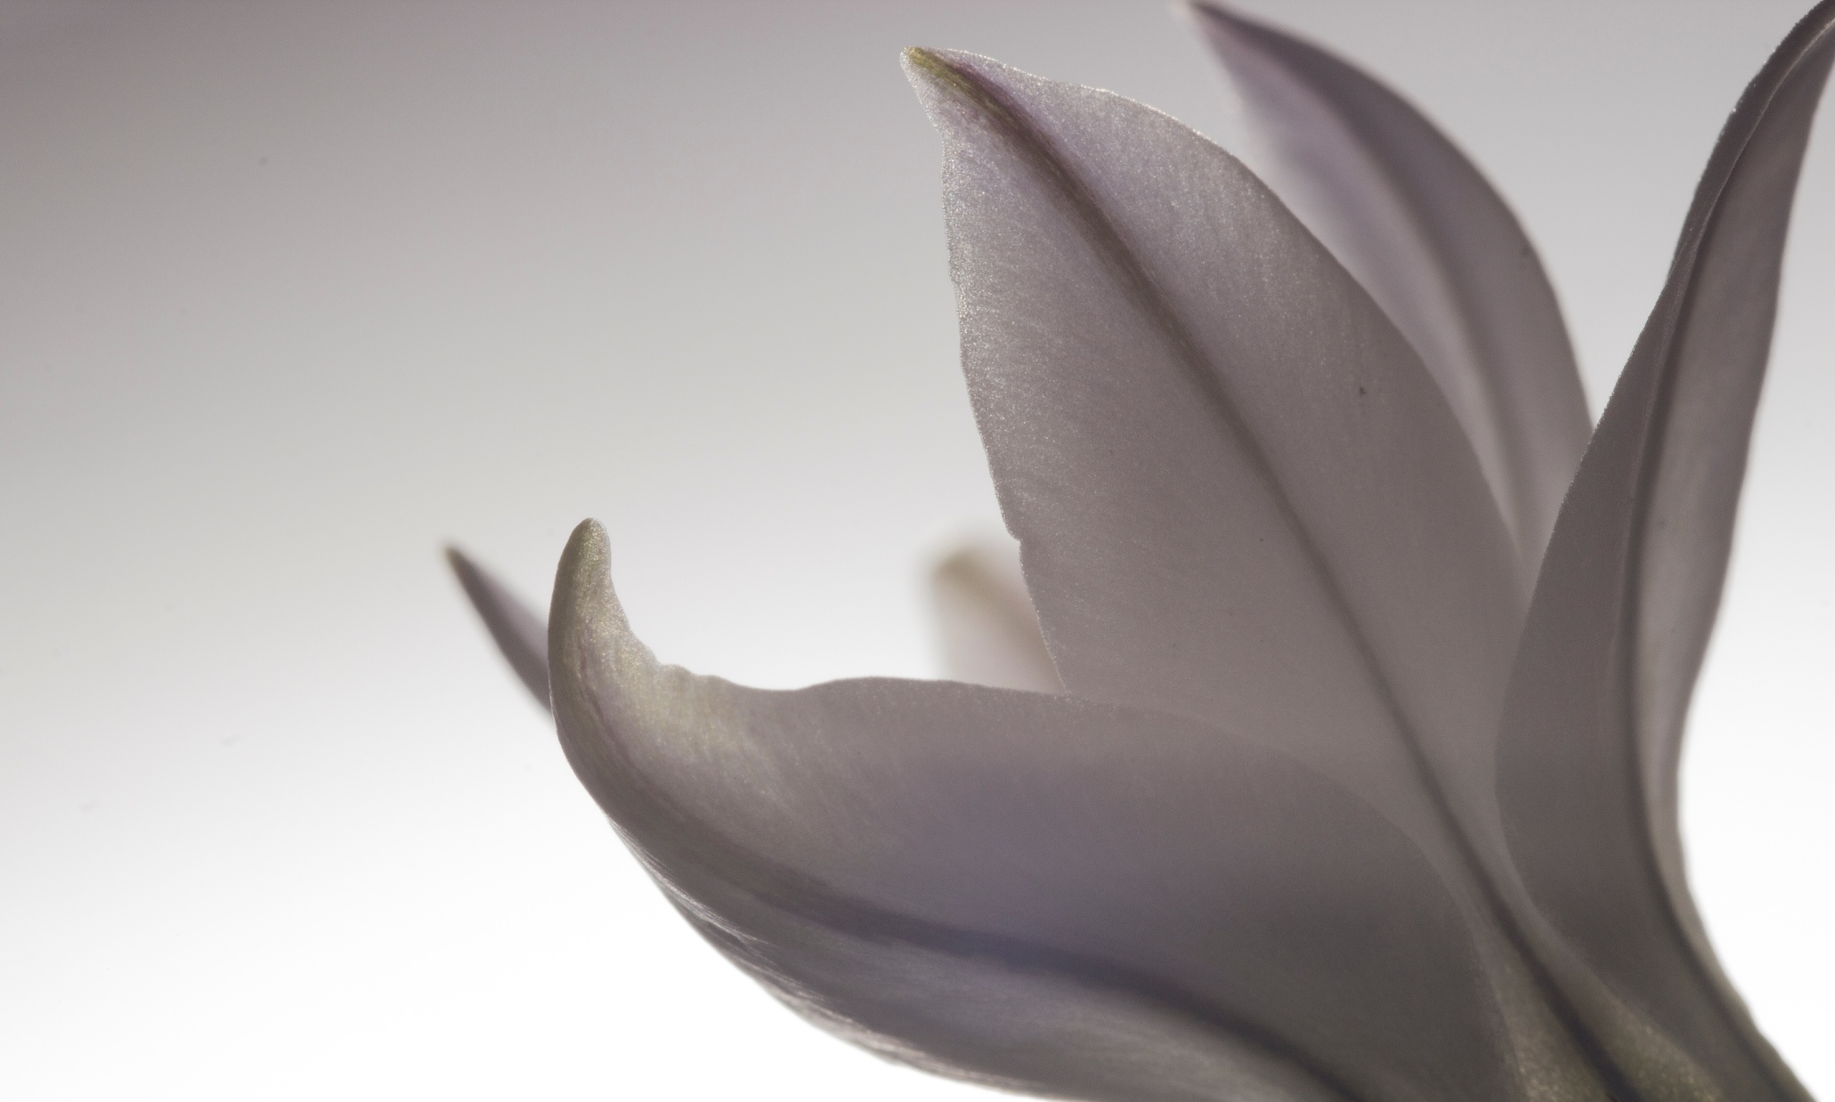

Slide 46
Final thoughts
Remember your Practical Portfolio is your personal study into a particular genre of photography.
Take LOTS of pictures
The more detailed your work is the better
The more Photos you have the better
Don’t be afraid of taking a bad picture
Don’t settle for an average photo. (If your not happy, do it again)
Most of the marks come from the Photos NOT writing

Slide 47
Mark scheme
Remember you are marked in four separate areas
DEVELOP:
EXPLORE:
RECORD:
PRESENT:
So make sure that in your work you are developing and exploring your ideas. Recording all of your work and making sure that the work is well presented and of a very high quality

Slide 48
Mark scheme
The assessment objectives
DEVELOP (24 marks) Develop ideas through sustained and focused investigations informed by contextual and other sources, demonstrating analytical and critical understanding. | Explore (24 marks) Explore and select appropriate resources, media, materials, techniques and processes in order to review and refine ideas as work develops.
Record (24 marks) Record observations and insights, reflecting critically on work and progress. | PRESENT (24 marks) Present a personal, informed and meaningful response that realises intentions and, where appropriate, makes connections between visual, and other elements.

