Slide 1

Year 11 Parent Information evening
A Few Crucial Months to go
Year 11
2025/2026

Slide 2
The Plan Ahead…
Start
Identify those students who are a concern and at risk of underachieving: contact with home to be made
Revision skills morning
After school support programme finalised
Parents Information evening
Mentoring begins
BASE CAMP
September
October
Reports completed by teachers
Reports sent home
Parents' Evening
November
Mock exam timetable for December sent home
Subjects start focussing on Mock Exam Prep
Year 11 Parents’ Evening
Sixth Form Open Evening
Sixth Form Applications
December
Dress up day!
Mock Exams – All subjects
Christmas time = half-way point!
SUMMIT

Slide 3
Biggest Factor
Attitude and commitment:
“ Excellence is never an accident. It is always the result of high intention, sincere effort and intelligent execution; it represents the wise choice of many alternatives - choice not chance determines your destiny.”
- Aristotle

Slide 4
Impact on Academic Performance
Increased Motivation: Parental encouragement and involvement can make a substantial difference in a student's motivation to work hard and cope with the academic demands of exams.
Higher Achievement: Research shows that parental support is a powerful factor in academic success, with studies indicating it's more influential than social class.
Skill Development: The process of preparing for and taking GCSEs helps students develop essential life skills, including communication, time management, organizational skills, and problem-solving

Slide 5
Qualifications
• GCSEs - All GCSE Exam grades have changed over to reporting in Numbers 9-1 with grade 8 being the equivalent of an old A* (roughly), Grade 4 being the equivalent of alow C (Pass) and Grade 5 being referred to as a ‘good/ strong pass’. (Grade 9s are only awarded to the top % of grade 8 students nationally (like an A**)
• BTECs - vocational subjects remain on Distinction*/ Distinction/ Merit/ Pass • A ‘Pass’ is the equivalent of a grade 4 in GCSE

Slide 6

The Use of Planners
What homework do you have?
• How long will that take?
• What equipment do you need to complete that?
• How do you think you might plan that piece of work?
• What are the key words that you need to use?
• Explain them to me?
• Show me how to do that?
• What did you learn?

Slide 7

Mock
Exams
Mck mOCK EXAMS Exams

Slide 8
Why are the Mocks important?
Mock exams are vital for practice; just as actors need a stage rehearsal before the real performance, so they need practice under exam conditions before they take the real exams in the summer.
Mock exams test your knowledge and let them, and their teachers know which topics are their strongest and weakest. You (and the students) can then plan revision based on giving more time to your weakest areas.
It will help them recall knowledge in their real exams. Their GCSE exams might seem a long way away, but if they revise thoroughly now, they will be amazed at how quickly and easily they will remember things when they revise a second time.
For subjects that are tiered, this will act as a ‘test run’ – they will not be able to enter for the Higher Tier in the summer unless they prove they can perform well in the mocks.

Slide 9

YEAR 11 STUDENT MARGINAL GAINS??
Homework
Analyse Past Papers
Prep fully for class tests and Mocks
On-line revision tools
Focus in
class
Asking for help
Catch up/Revision sessions
Tutor Time

Slide 10
What makes effective revision?
Attendance to revision sessions
Dedicated time, space and
resources
Focus on knowledge
Focus on exam technique
Completion of homework

Slide 11


What doesn’t work?
Passive re-reading of notes and textbooks

Slide 12
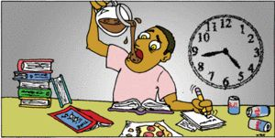
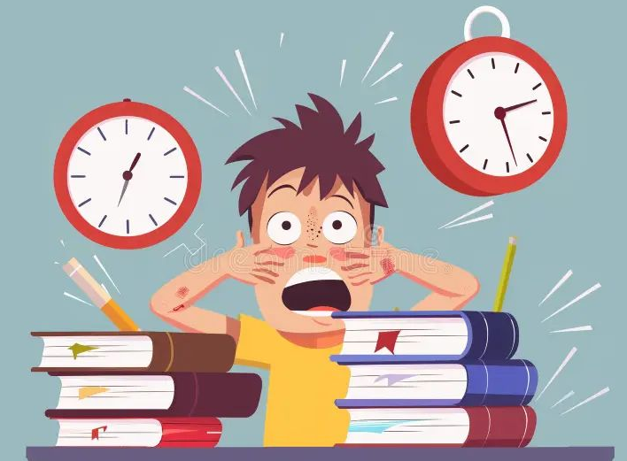
What doesn’t work?
Cramming for hours

Slide 13
What does work?
Start early: Begin revising well in advance to allow time for spaced repetition.
Space out sessions: Distribute your revision over time, rather than cramming, which improves long-term memory retention.
Switch topics: Vary your study sessions by switching between different subjects or topics, which keeps your learning fresh and helps you make connections.

Slide 14
Where to get help …
If you have questions or concerns as a parent, there are 3 main points of contact:
Form tutor
Head of Year – Mrs. Webb
Hed.webbv@hedingham.essex.sch.uk
3. Deputy Head – Mr. Abrey
Hed.abreyc@hedingham.essex.sch.uk

Slide 15



HEDINGHAM SCHOOL AND SIXTH FORM
In Class
Be punctual
  Be on time. No excuses.
Be equipped
  All basic equipment, including a Scientific calculator
Be respectful to all others
  If you persistently disrupt learning, you will be removed.

Slide 16
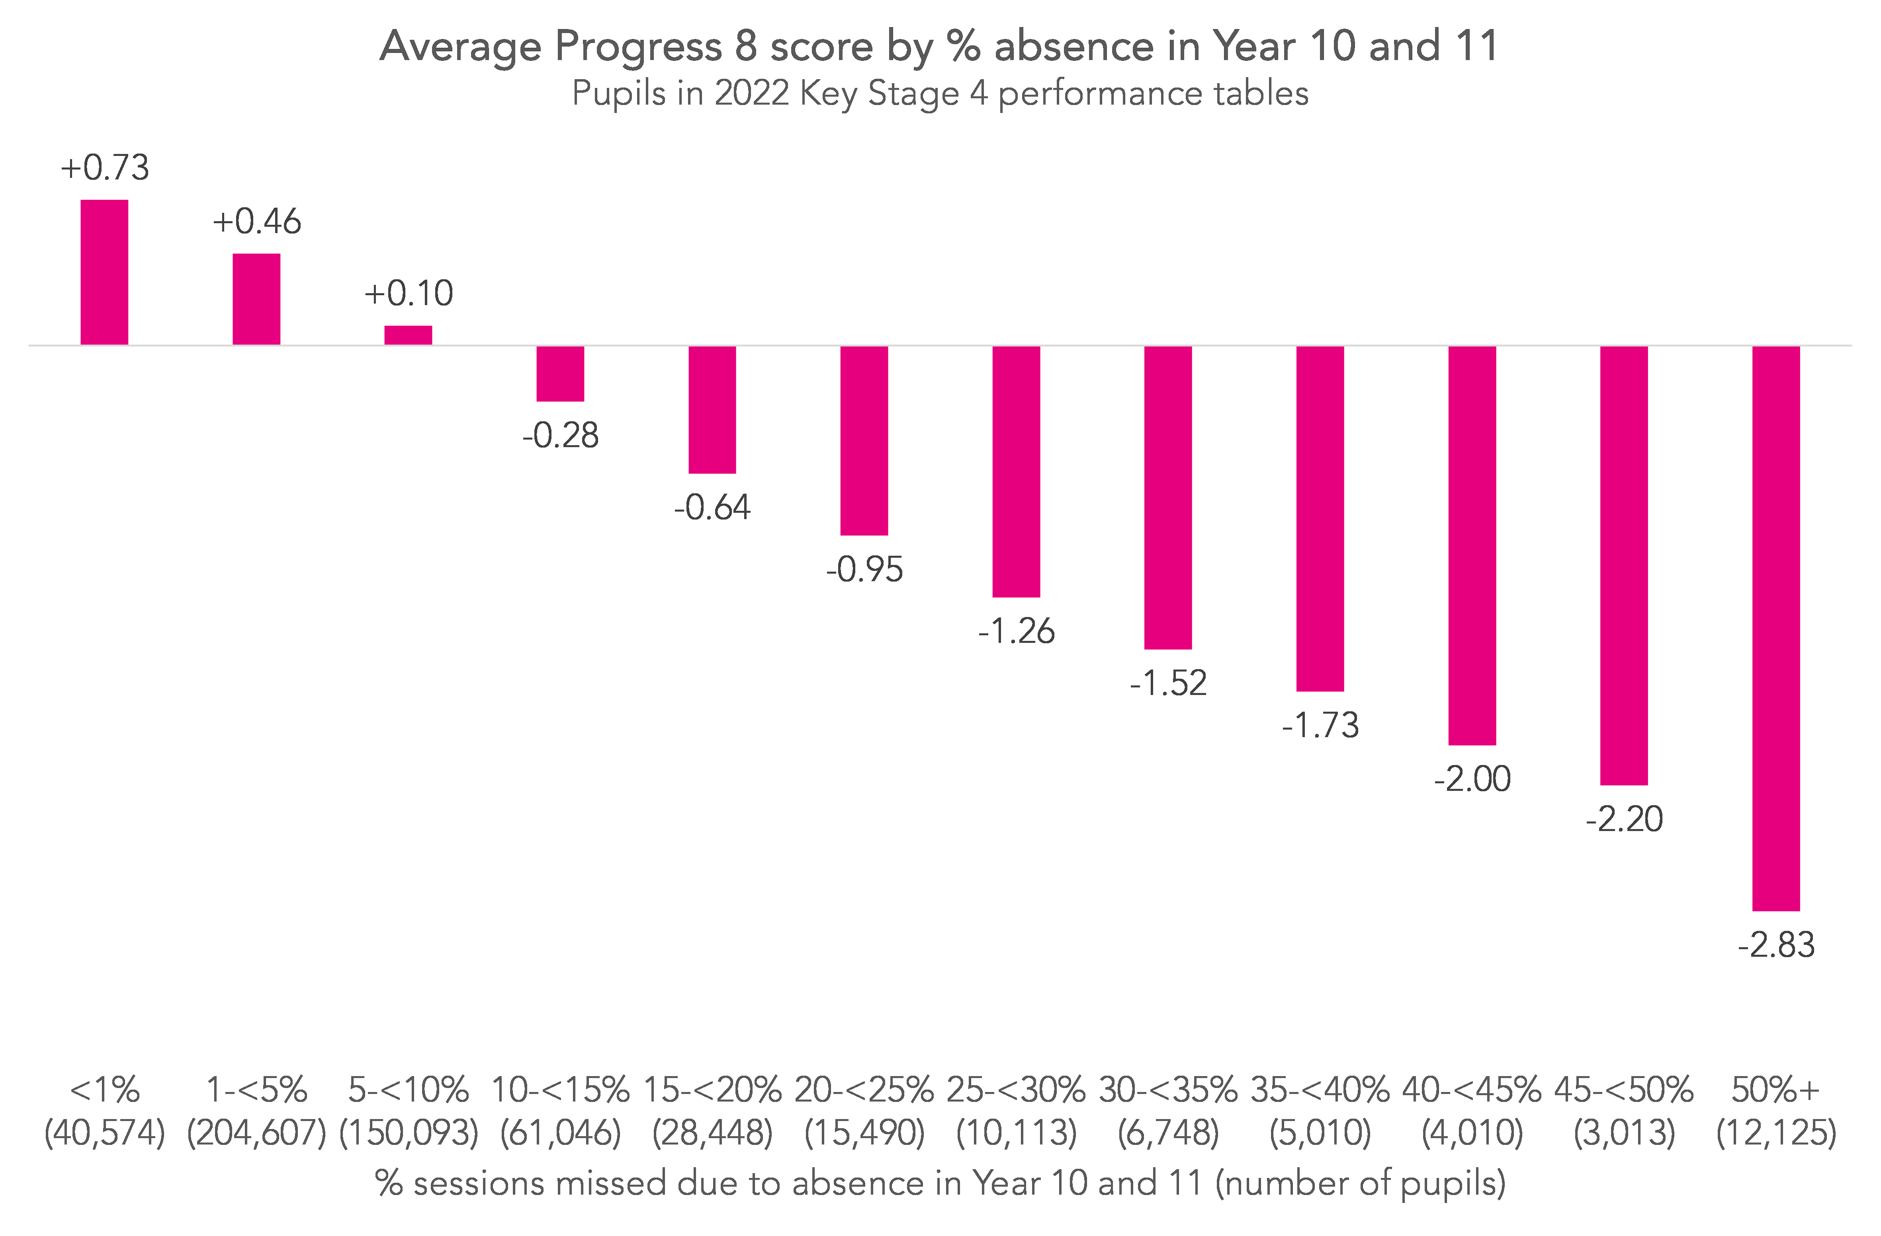
HEDINGHAM SCHOOL AND SIXTH FORM
Attendance
If attendance drops bellow 90% you are likely to miss your target grades by 1/3 of a grade per subject.
If you drop below 80% you’re going to underperform by 1 grade in EVERY subject
If you have over 95% attendance you are likely to exceed your target in half your subjects

Slide 17
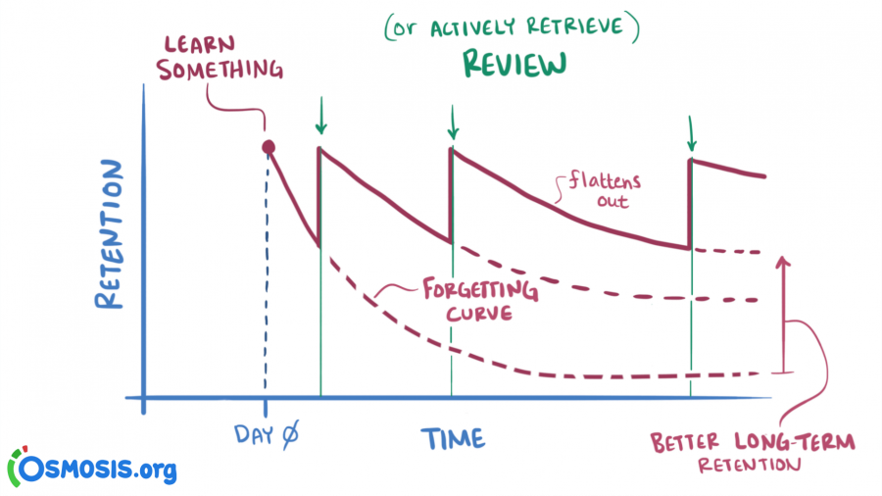
HEDINGHAM SCHOOL AND SIXTH FORM
Out of class
We are offering a comprehensive revision programme outside of lesson time
Everyone is welcome to attend, we will be targeting certain students
You may receive letters home, and see a Period 6 put on your timetable

Slide 18

HEDINGHAM SCHOOL AND SIXTH FORM
How grading works…
The score you achieve on your papers will be added up, and you will have a total.
That total will place you on a national leaderboard, where you will be ranked between 1st and approximately 650,000th
Depending on where you rank, will depend on your grade.
Your job, is to get as high up the rankings as possible.
EVERY MARK COUNTS

Slide 19
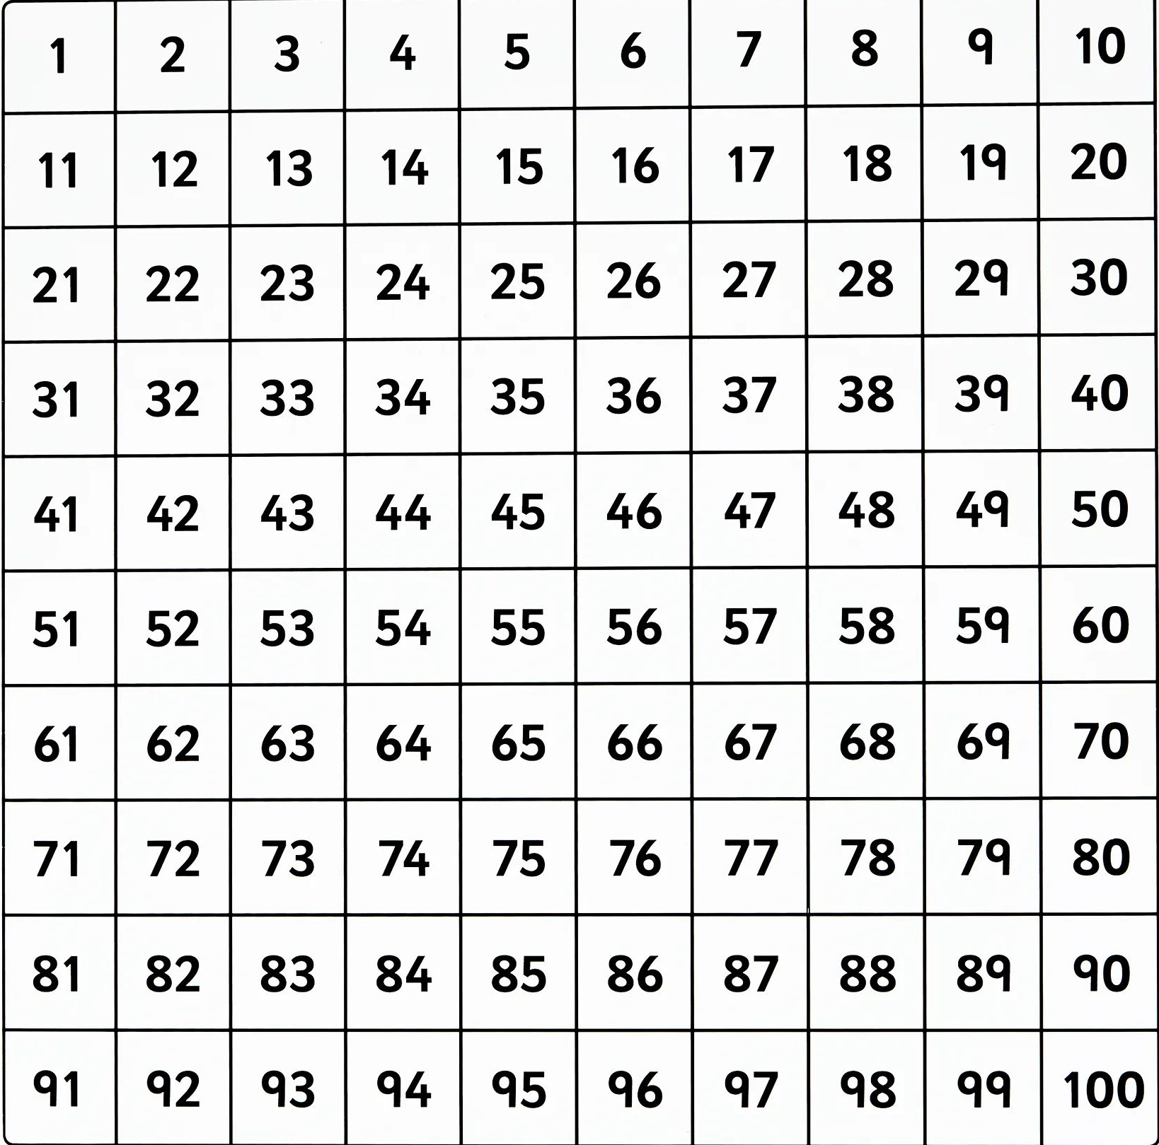
HEDINGHAM SCHOOL AND SIXTH FORM
Working out your grades
Top 3% - Grade 9
Next 6% (in the top 9%) – Grade 8
Next 7% (in the top 16%) – Grade 7
Next 9% (in the top 25%) – Grade 6
Next 15% (in the top 40%) – Grade 5
Next 20% (in the top 60%) – Grade 4
Next 19% (in the bottom 39%) – Grade 3
Next 13% (in the bottom 20%) – Grade 2
Next 6% (in the bottom 7%) – Grade 1
Next 2% (in the bottom 2%) – Grade U

Slide 20
HEDINGHAM SCHOOL AND SIXTH FORM
Maths Key Information
Exam Board: Edexcel (also known as Pearson)
Tier: You will be doing either the Foundation paper or the Higher paper – if you’re not sure, check with your teacher
Three Papers: 1hr 30mins each
Each is worth 80 marks and has an equal weighting in the final grade – it doesn’t matter what you get on an individual paper, just the overall total point score
One paper is non calculator, the other two are calculator papers

Slide 21
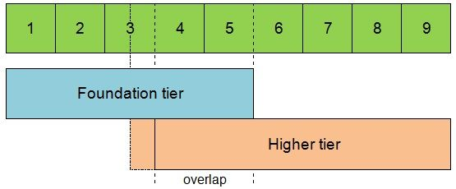
HEDINGHAM SCHOOL AND SIXTH FORM
How to revise for Maths
On your results, or your GCSE certificate, there is no indication of which tier you sat
Over half the questions on the Higher paper are Grade 7 (old Grade A) and above

Slide 22
HEDINGHAM SCHOOL AND SIXTH FORM
How to revise for Maths
Complete Past Papers
Hand in to your teacher (or mark yourself)
Look at the questions you got wrong
Identify the topics
Practice questions/use revision guides/youtube videos to improve
Your revision should form constant loop of improvement
It should focus around practicing past papers, and identifying key areas of improvement

Slide 23
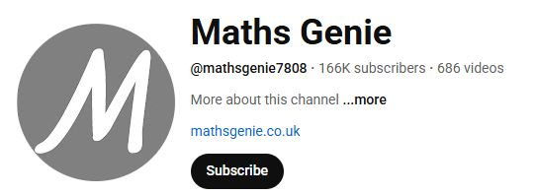
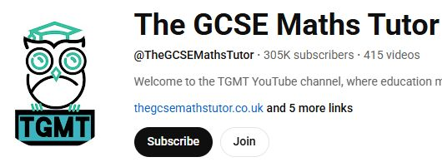
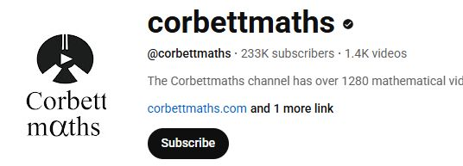
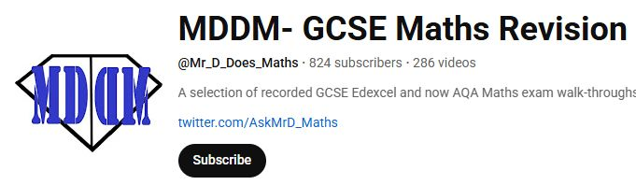
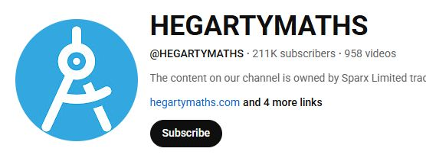
HEDINGHAM SCHOOL AND SIXTH FORM
How to revise for Maths
There are loads of youtube pages with exam paper and exam question walk throughs
Pause the video, attempt the question, follow through the solution

Slide 24
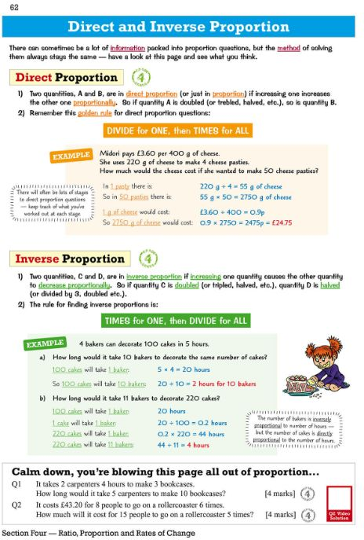
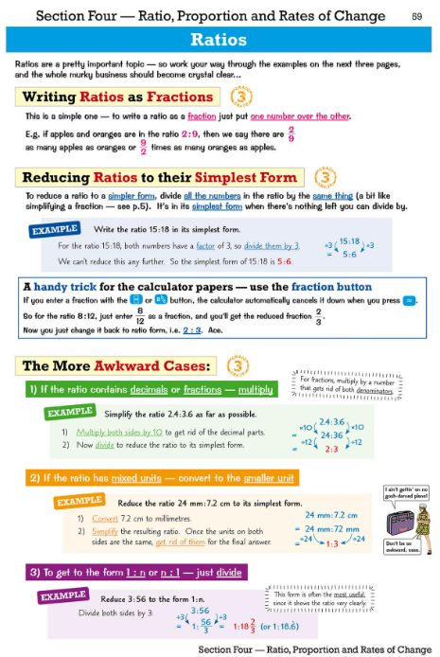
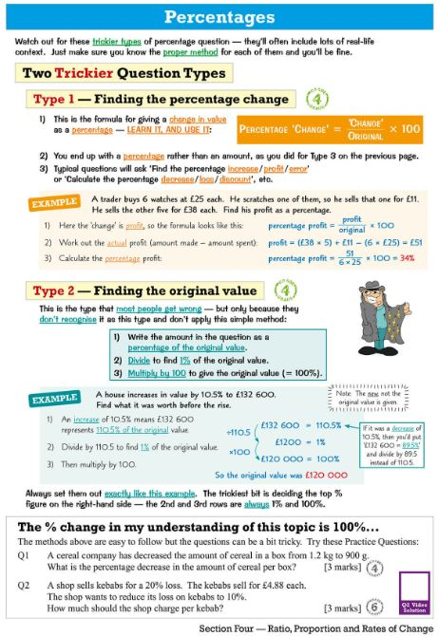
HEDINGHAM SCHOOL AND SIXTH FORM
How to revise for Maths
CGP Revision guides are really helpful
About £6 each on Amazon
Choice of revision guide – notes pre made for you (comes with online videos and quizzes)
Workbook – questions and solutions
Exam style past papers – exam practice

Slide 25
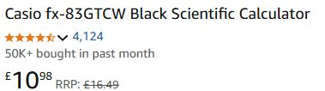
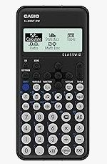
HEDINGHAM SCHOOL AND SIXTH FORM
How to revise for Maths
2/3 of your maths exams are calculator exams
You NEED your own scientific calculator
Easiest place to get them is Amazon
THIS IS THE ONE YOU WANT TO BUY
Go for the Casio (if you can) – there will be other brands a pound or two cheaper

Slide 26
English

Slide 27
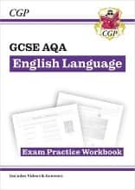

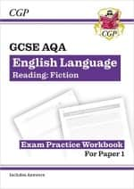
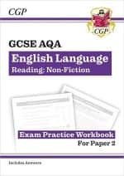
English language Paper 1
Thursday, 21 May 2026.
English Language Paper 2
Friday, 5 June 2026.
AQA English Language Papers 1 and 2
Paper 1 : One Unseen Text (20th or 21st Century)
Paper 2: Two Unseen Texts (one 19th Century)
Teams page ‘Year 11 English 2025-2026’ where students will find examples of past papers, mark schemes and knowledge organizers for each paper.
Students should examine one paper with the mark scheme over one or two evenings, then sit another paper in exam conditions the next evening/ over a weekend. There are lots of papers on there!
Parental support could mean making sure they have a quiet environment to work in with lots of space, purchasing the revision guides and rewards!

Slide 28
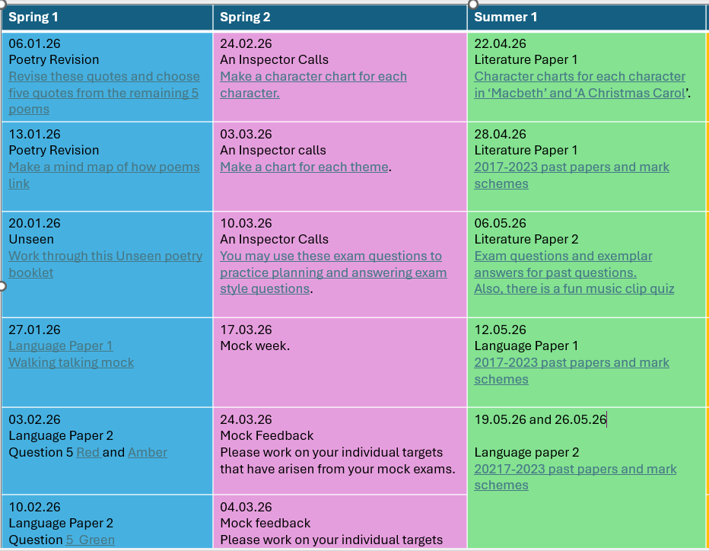
After school revision and homework.
AQA English Language and Literature
Revision classes after school every Monday.
Lunchtime revision:
Miss Nevil (Mon) and (Fri)
Miss Butler (Thur)
Teams page ‘Year 11 English 2025-2026’ where they will find examples of past papers, knowledge organisers for each paper.
Hand their work to a teacher to mark and check.

Slide 29
For each novel, play and poem
Where else can you find revision materials
Seneca
BBC Bitesize
Sparx reader – Set Literature texts with easy reader versions available
Mr. Bruff you tube videos
TikTok: Mr. Everything English, The Lightup Hub, and English with Lucy
Make mind maps
Make flash cards
Draw Venn diagrams
Make character profiles
RAG their knowledge
Speak to their teachers about gaps in knowledge.

Slide 30
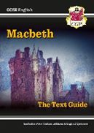




We expect that all exam texts are being reread at home.
Question children about the themes, characters, context.
Students need to learn key quotes for each poem, every character and all themes for all set texts.
Paper 1 Monday, 11 May
Paper 2 Tuesday, 19 May
AQA English Literature
Paper 1
Section A: ‘Macbeth’
Section B: ‘A Christmas Carol’
Paper 2
Section A: ‘An Inspector Calls’
Section B: ‘Power and Conflict’ Poetry
Section Ci: Unseen Poetry
Section Cii: Unseen comparison.

Slide 31
Science

Slide 32
What makes good science revision?
Science Revision
Blurting (writing everything you know)
Active Recall (Questions)
Summarizing topic info into Mind Maps
RAG the scheme of work
Past Paper Questions
ACTIVE REVISION
School Revision Sessions
Timed Questions
Seneca Learning
Equation practice
Six Mark Questions
Start early and chunk topics over time
1 Hour
Revision
B
Revision
B

Slide 33





What resources can be used?
Science Revision
Edexcel (Combined / Triple)
Foundation / Higher
BIO
BIO
CHEM
CHEM
PHYS
PHYS
Edexcel Past Papers
Seneca Learning
BBC Bitesize
Physics and Maths Tutor
Isaac Physics
Bought revision guides
Hedingham Science Teams Revision Page
YouTube Revision Sessions
  FreeScienceLessons

Slide 34
Mr. Hyde
Head of Sixth Form

Slide 35

Hedingham Sixth Form
What have we done so far
  Taster Day
  Subject Talks in assembly
  Careers events
  Headship elections (Next week)
What we are going to offer
  Printed prospectus
  Open Evening (Thursday 13th November 6 – 8.00pm)
  Subject marketplace
  Sixth Form Drop in Sessions
  Applications and Interviews
  Year 11 Taster Day (Summer Term)

Slide 36
Hedingham Sixth Form Application Process
Application process formally opens after Open Evening
  (They can apply before!)
Interview process
  December 2025 (Official date TBC)
Applications can change
  Students can change options
Questions about subjects/Sixth Form in general

Slide 37
Rewards and Wellbeing
Head of Year

Slide 38

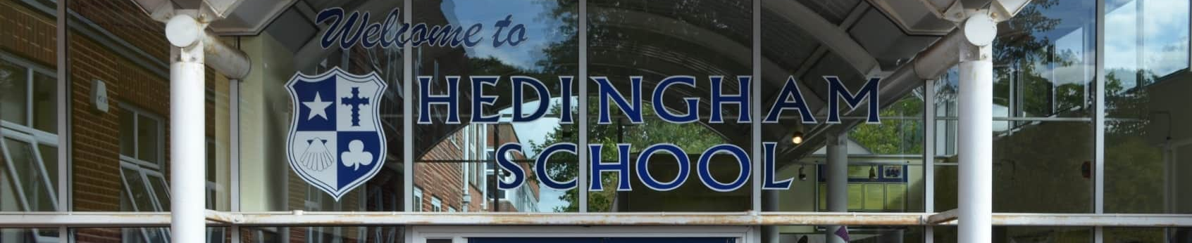

Year 11 Rewards Passport

Slide 39
The Rewards
Each term you will be working towards a different Year 11 reward.
The reward will take place in the following half term.
  Autumn Term – Dress Up Day
  Spring Term – Thorpe Park
  Summer Term – Prize Draw
Attendance to Prom will be depending on overall behaviour, rather than credits alone

Slide 40
Gaining/Losing Credits
For the first milestone, students will be required to attain 60 credits.
Gaining Credits:
  Achieving weekly 100% punctuality to all lessons = 5 credits
  One house point = 1 credit
    Attitude/Effort/Homework etc
  Completion of revision card = 16 credits (2 per revision session).
Losing Credits:
  They will lose a credit for every behaviour point they receive.

Slide 41
Recording and Monitoring
Form tutor will be monitoring punctuality and awarding credits.
Collecting revision cards and awarding credits.
Every house point they receive will convert to a credit.
Every behaviour point will deduct a credit.
At the end of the week, they will have a credits total, noted by their form tutors

Slide 42
Physical ‘Passport’
They will need to earn 60 credits by the end of November in order to qualify for the first reward (Dress Up Day)
The next target will be set in January 2026

Slide 43




Exam Stress

Slide 44
Where to get help
If you have questions or concerns as a parent, there are 3 main points of contact:
Form tutor
2. Head of Year – Mrs. Webb
Hed.webbv@hedingham.essex.sch.uk
3. Deputy Head – Mr. Abrey
Hed.abreyc@hedingham.essex.sch.uk

